Slide 1
AI-Augmented Software Development Life Cycle SEZG534
Akshaya Ganesan
CSIS, WILP

Slide 2
Contact Session: 4 – Fundamentals of AI

Slide 3
Artificial Intelligence
The fundamentals of Artificial Intelligence (AI) combine computer science, mathematics, and data to create systems capable of tasks that typically require human intelligence.
The core capabilities that allow AI systems to mimic human thought processes are
1. Learning
2. Reasoning
3. Perception
4. Problem-Solving/Action

Slide 4
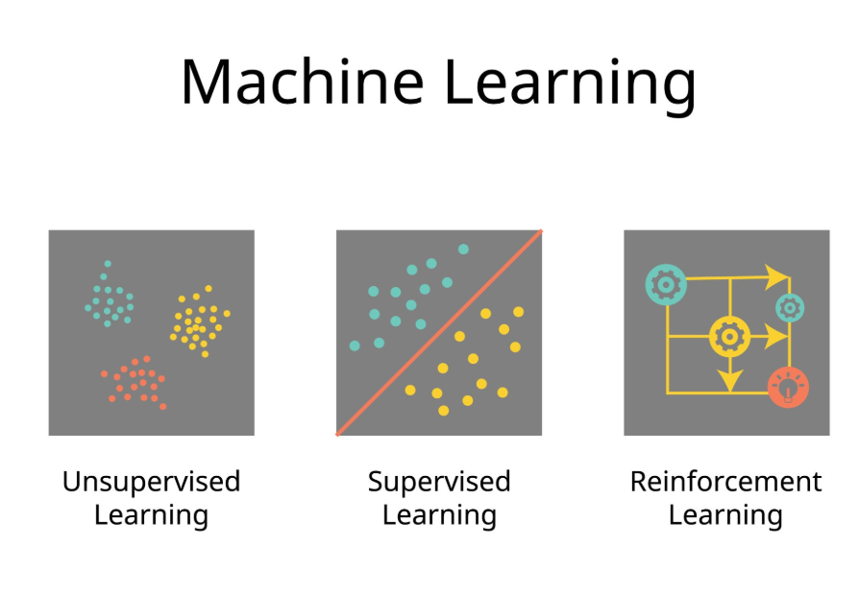
1. Learning
It is the process by which an AI improves its performance on a task over time by extracting patterns from data, rather than being explicitly programmed with hardcoded rules.

Slide 5
Machine learning
Machine Learning (ML): ML models use statistical AI to autonomously train on sample data and optimize their performance over time without explicit programming.
ML Techniques:
Supervised Learning: Requires human-labeled training data (such as tagging images as "dog" or "cat").
Unsupervised Learning: Does not use labels; instead, it detects inherent clusters and patterns (frequently used in e-commerce recommendation engines).
Reinforcement Learning: Learns trial-and-error behaviors by receiving systematic rewards or penalties (e.g., self-driving cars, stock trading).
Deep Learning: An evolved subset of unsupervised learning modeled on neural networks to mimic the human brain, utilizing forward propagation to process data and backpropagation to correct errors. Deep learning is a subset of machine learning driven by multilayered neural networks whose design is inspired by the structure of the human brain.

Slide 6
AI and ML
Rule-Based AI: The simplest models (e.g., rules engines, expert systems, symbolic AI, knowledge graphs) rely on explicit "if-then-else" statements programmed by humans.
AI models can automate decision-making, but only models capable of machine learning (ML) are able to autonomously optimize their performance over time.
While all ML models are AI, not all AI involves ML.

Slide 7
2. Reasoning
Reasoning is the ability to connect facts, apply logic, and derive new conclusions from existing information or premise statements.
How AI Approaches It:
Symbolic & Knowledge-Graph AI: Uses strict mathematical logic and predefined "if-then" rule frameworks to draw explicit, guaranteed deductions.
Probabilistic & Statistical Inference: Estimates the likelihood of various outcomes based on incomplete data using Bayesian networks or statistical distributions.
Chain-of-Thought (Neural Reasoning): Modern Large Language Models break complex prompts down into intermediate logical steps before generating a response, mimicking human step-by-step thinking.

Slide 8
3. Problem-Solving
Problem-Solving involves identifying a desired goal state and searching for or generating a sequence of actions to reach that goal from a current starting point.
How AI Approaches It:
Search & Optimization Algorithms: AI evaluates possible future moves using state-tree searches (like A* search or Monte Carlo Tree Search) to navigate massive decision spaces (e.g., chess, logistics routing).
Agentic Planning: Autonomous AI agents break down a complex, high-level task into actionable sub-tasks, execute tools or API calls, check intermediate outputs, and re-plan if an step fails.
Constraint Satisfaction: Systems analyze mathematical parameters to find valid configurations that meet strict criteria (e.g., airline flight scheduling).

Slide 9
4. Perception
Perception is how an AI system receives raw physical or visual sensor data from the real world and translates it into structured, meaningful representations.
How AI Approaches It:
Computer Vision: Convolutional Neural Networks (CNNs) and Vision Transformers process raw pixel matrices to detect objects, segment scenes, and measure depth in real time (e.g., autonomous driving).
Speech & Audio Processing: Models convert continuous sound frequencies into text tokens using acoustic spectral models.
Multimodal Fusion: Modern frontier models combine text, image, audio, and sensor inputs simultaneously into unified mathematical spaces, allowing the AI to "see" and "hear" contexts as a single integrated stream.

Slide 10
The evolution of AI
Symbolic Logic Systems: Symbolic logic systems mark the earliest phase of AI, utilizing rules and logical principles to represent knowledge and draw conclusions
Traditional Machine Learning (1990s–2010s)
Deep Learning & Foundation LLMs (2017–2023)
Test-Time Compute & Reasoning Models (2024–Present)

Slide 11
Large Language Models
A language model encodes statistical information about one or more languages. Intuitively, this information tells us how likely a word is to appear in a given context.
The basic unit of a language model is token.
What’s special about language models that made them the center of the scaling approach that caused the ChatGPT moment?
Self-supervision
How large does a language model have to be to be considered large?
A model’s size is typically measured by its number of parameters.

Slide 12
Foundation Models (The Base)
A Foundation Model is a massive, general-purpose AI system trained on vast, multimodal data (text, images, code, audio) using self-supervised learning.
Deep learning models are most trained through supervised learning on labeled data to perform regression and classification tasks.
But because large-scale neural networks usually require a massive amount of training data which adds to cost and labor, using unlabled data was introduced.
Self-supervised learning has since emerged as a prominent mode of training neural networks, particularly for the foundation models underpinning generative AI.

Slide 13
Large Language Models- Transformers
LLMs are built on a type of neural network architecture called a transformer which excels at handling sequences of words and capturing patterns in text.
LLMs are initially trained with self-supervised learning.
Transformer models, introduced in 2017, are useful due to their self-attention mechanism, which allows them to “pay attention to” different tokens at different moments.
https://poloclub.github.io/transformer-explainer/

Slide 14
A reasoning model
It is a large language model (LLM) that has been fine-tuned to perform multi-step problem-solving by generating intermediate steps, often called “reasoning traces”.
A reasoning model generates an internal, hidden chain of thought before writing a single line of output. It allocates extra compute time at inference to test hypotheses and verify logic
In the context of reasoning LLMs, AI research literature often references “System 1” and “System 2” thinking

Slide 15
System 1 and System 2 Thinking
System 1 and System 2 thinking describes two distinct modes of cognitive processing introduced by Daniel Kahneman in his book Thinking, Fast and Slow.
System 1 is fast, automatic, and intuitive, operating with little to no effort. This mode of thinking allows us to make quick decisions and judgments based on patterns and experiences.
In contrast, System 2 is slow, deliberate, and conscious, requiring intentional effort. This type of thinking is used for complex problem-solving and analytical tasks where more thought and consideration are necessary.

Slide 16
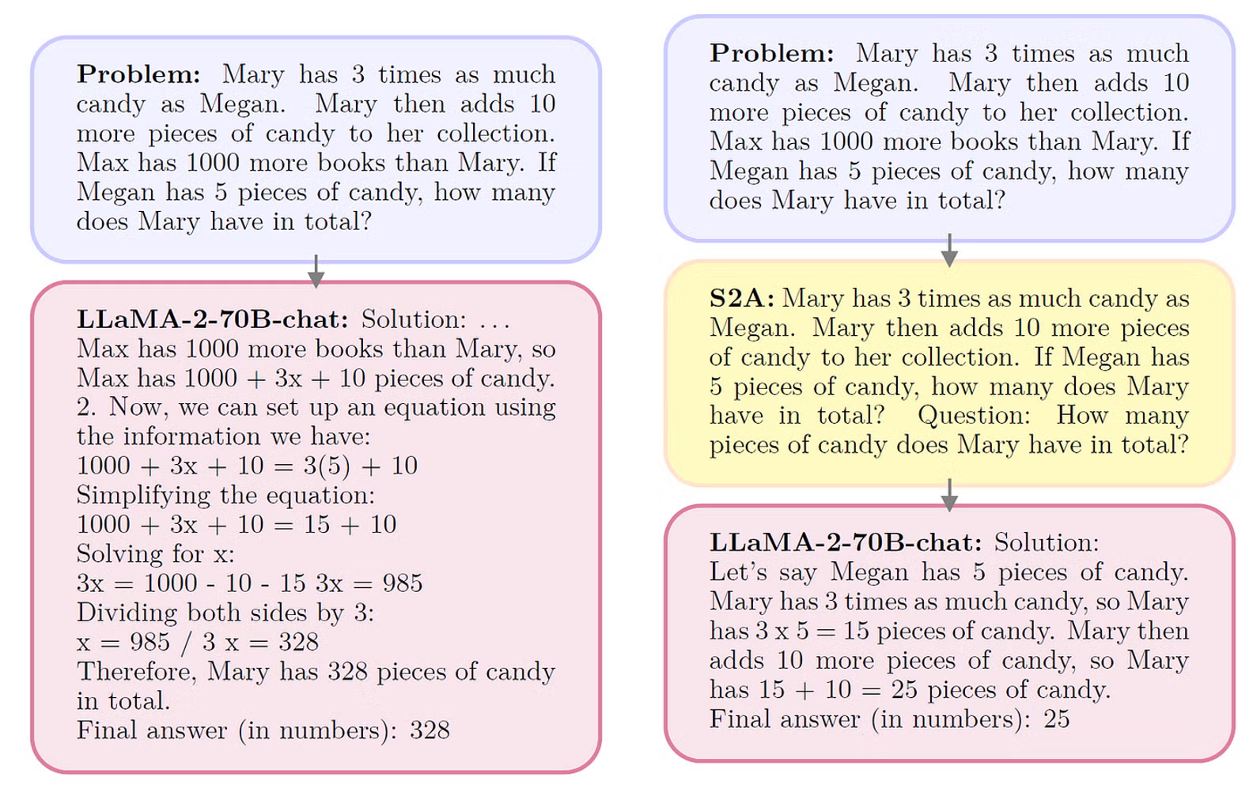
System 2 Attention” (S2A)
S2A, an early inference scaling method. By adding steps between input and response—in this case, to rewrite the original prompt—the model improves its final output. Taken from the paper "System 2 Attention (is something you might need too)."

Slide 17
Real-World Usecase
Automated Code Bug Fixing
Consider fixing a critical bug in a complex microservices codebase
Traditional ML: Identifies which line or file likely contains a bug based on historical commit log classification, but cannot write or evaluate the fix.
Standard LLM: Inspects the buggy function and rapidly writes a plausible patch. However, it may overlook edge-case race conditions or introduce breaking API changes elsewhere because it outputs the solution in a single pass.
Reasoning Model:
Executes an internal scratchpad thought process:
Traces the call stack across services mentally.
Hypothesizes three potential root causes (memory leak, null pointer, race condition).
Simulates running the code against edge cases to disprove 2 of the hypotheses.
Drafts the fix, double-checks for breaking dependencies, and only then outputs the final code block.

Slide 18
Tokenization.
A token can be a character, a word, or a part of a word (like -tion), depending on the model.
The process of breaking the original text into tokens is called tokenization.
Why do language models use token as their unit instead of word or character??
https://platform.openai.com/tokenizer

Slide 19
References
https://www.ibm.com/think/topics/ai-model
https://www.ibm.com/think/topics/reasoning-model#692473874
AI Engineering: Building Applications with Foundation Models by Chip Huyen , Oreilly, 2025

Slide 20
Thank you

